Slide 1
Project Crashing and
Time-Cost Trade-Off Overview
Project duration can be reduced by assigning more resources to project activities.
However, doing this increases project cost.
Decision is based on analysis of trade-off between time and cost.
Project crashing is a method for shortening project duration by reducing one or more critical activities to a time less than normal activity time.
Dr.Bokkasam Sasidhar

Slide 2
Project Crashing and Time-Cost Trade-Off
General Relationship of Time and Cost
Project crashing costs and indirect costs have an inverse relationship.
Crashing costs are highest when the project is shortened.
Indirect costs increase as the project duration increases.
The optimal project time is at the minimum point on the total cost curve.
Dr.Bokkasam Sasidhar

Slide 3
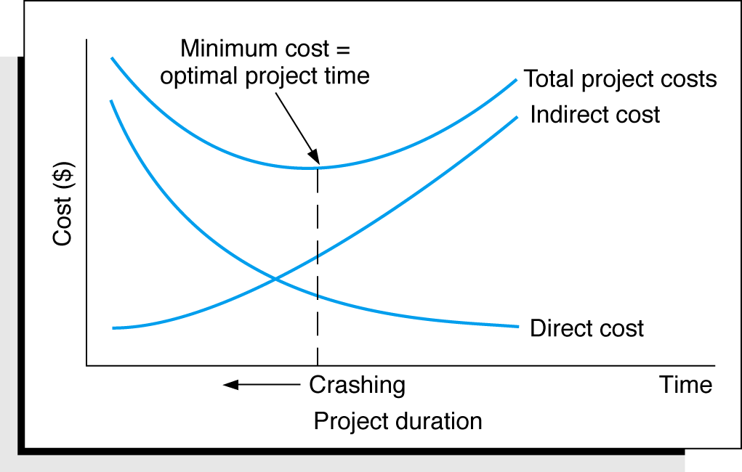
Project Crashing and Time-Cost Trade-Off
General Relationship of Time and Cost
The time-cost trade-off
Dr.Bokkasam Sasidhar

